Slide 1
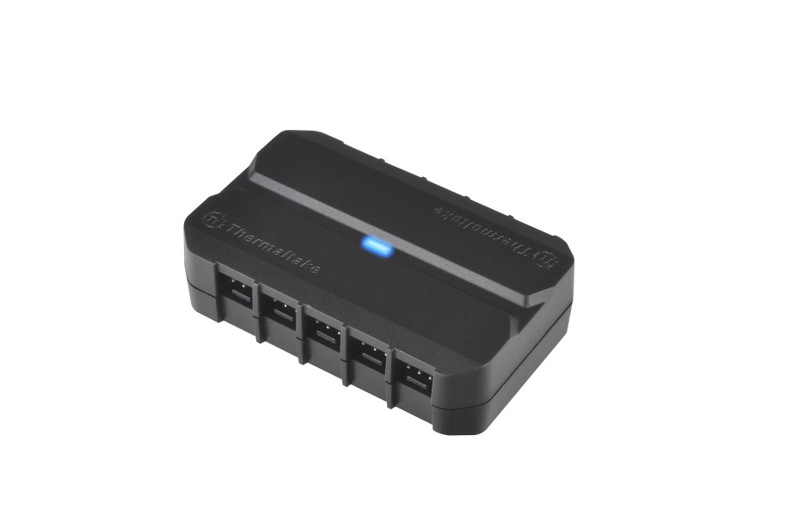
Thermaltake Commander Series
Commander FX – 10 Port Fan Hub
Works with all 3-pin fans
Features
P/N: AC-007-AN1NAN-A1
Support up to 10 independent fans
Blue LED provides power indication
Direct SATA power input
Simple and clean cable management
High quality and symmetry design
Experience the unrivaled airflow and water cooling capabilities
Easily releasable and reusable beaded cable ties
Specification
P/N | AC-007-AN1NAN-A1
Weight | 30g
Dimension | 70 x 45 x 20 mm
Material | Plastic
Main Function | Fan Splitter
Color | Black
Accessories | Beaded cable ties x 5 Velcros x 2
Connection ports | 3-Pin x 10 ; SATA x 1
DC Input | +12V
www.thermaltake.com
thermaltake@thermaltake.com
REVISION A. 2014.05

Slide 2

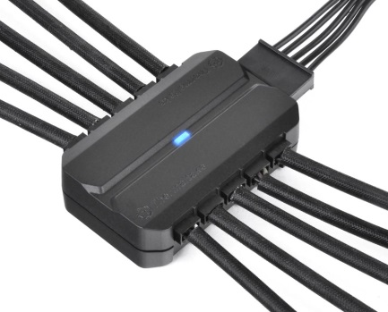
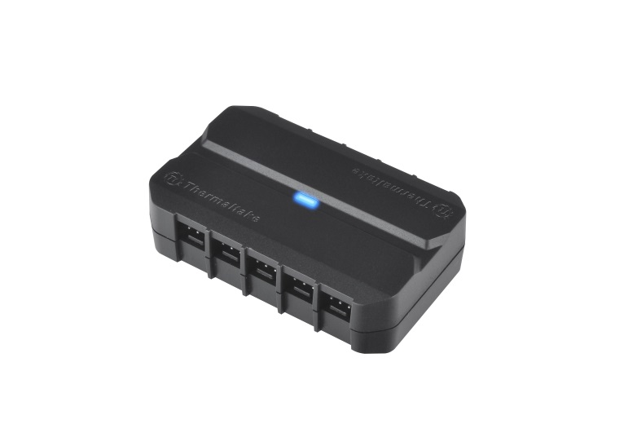

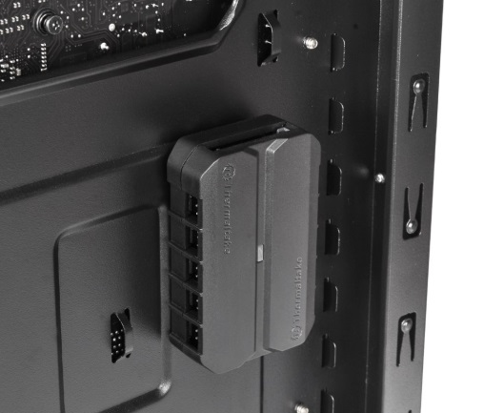
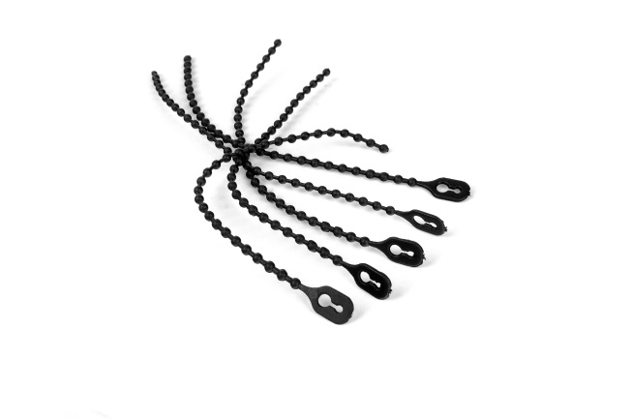
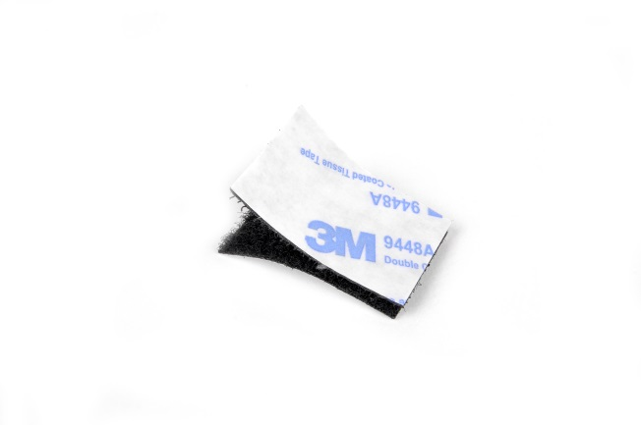
Thermaltake Commander Series
Detail Features
Convenient SATA power input
10 channels support up to 10 independent fans
Blue LED provides power indication
simple and clean cable management
Beaded cable ties and velcros
High quality and symmetry design
www.thermaltake.com
thermaltake@thermaltake.com
REVISION A. 2014.04

Slide 3
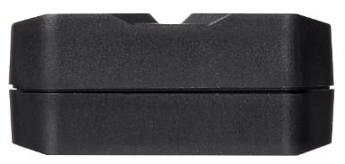
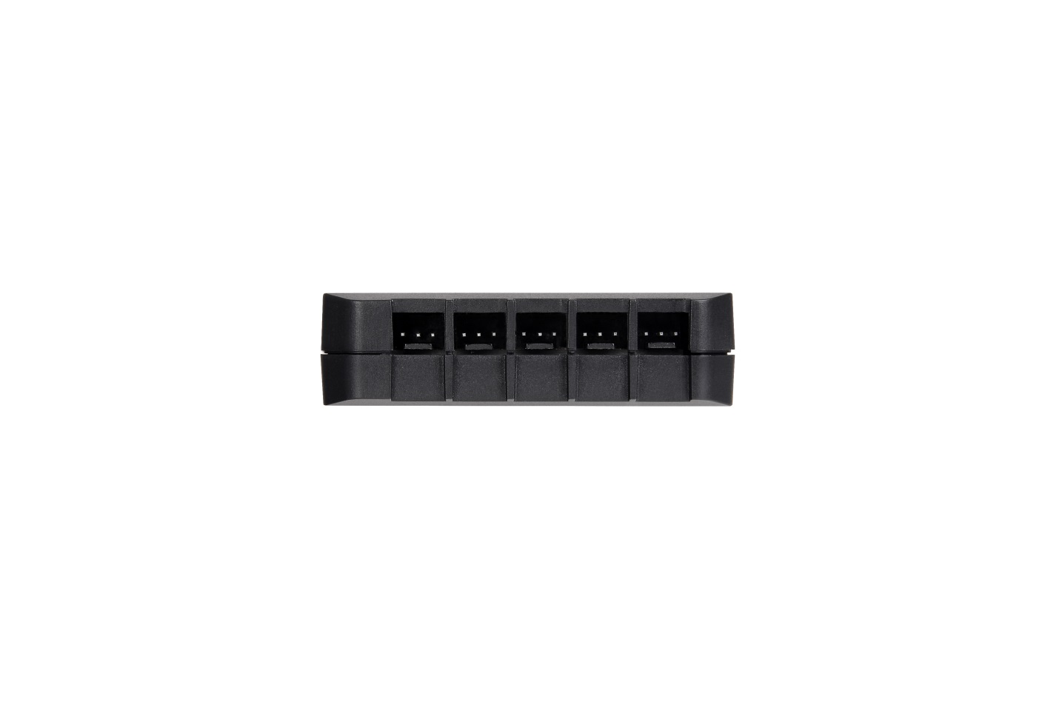
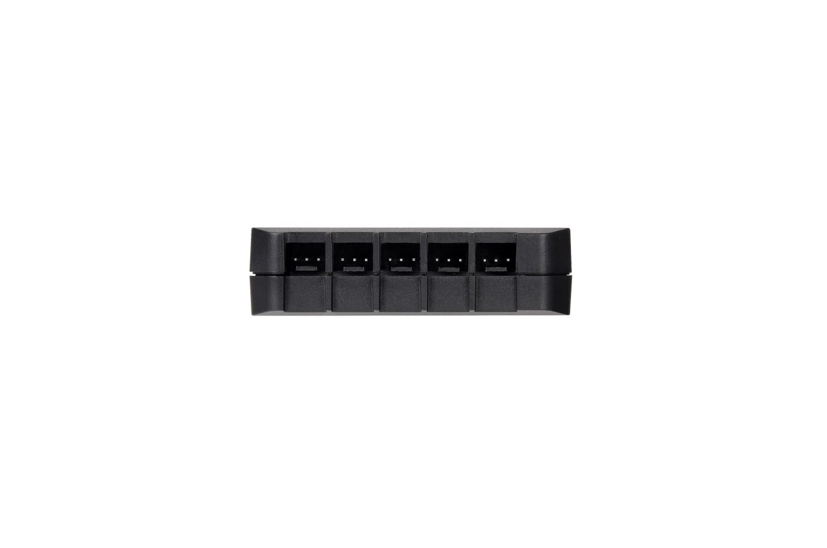
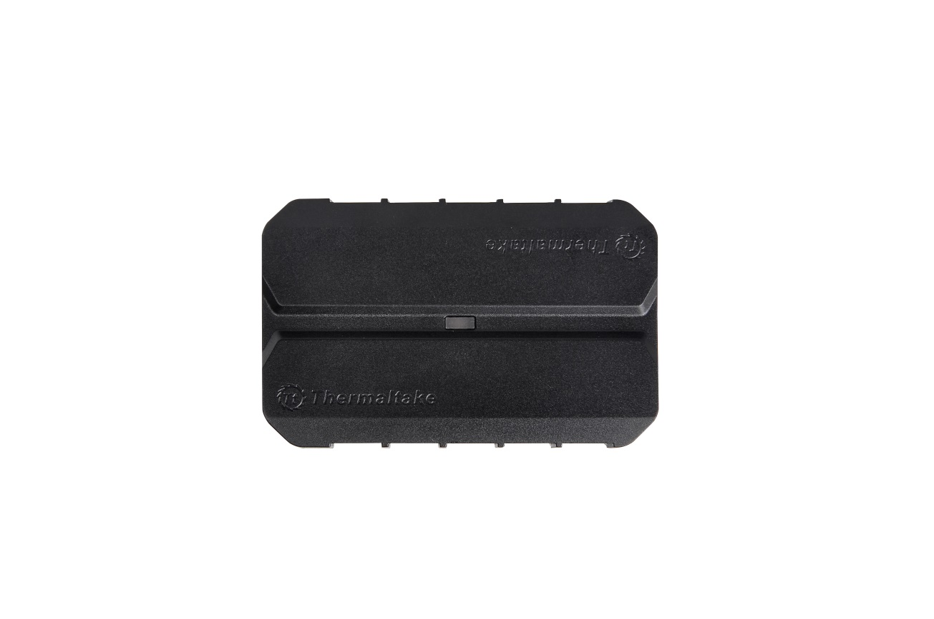
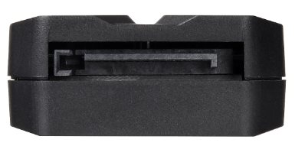
Thermaltake Commander Series
Appearance
(a)
(b)
(b)
(c)
(a) LED indicator
(b) 3-Pin power output
(c) SATA power input
www.thermaltake.com
thermaltake@thermaltake.com
REVISION A. 2014.05

